Slide 1
Raid of the Restless

Slide 2
The dark caverns and mysterious catacombs call to all of us in a one way or another. But sometimes it takes more than one hero to complete the quests he will face. After conjoining at a local tavern you and three fellow travelers have decided to go for gold and riches, but it won’t be as simple as it looks, everyone will play apart in this adventure in order to gain fame and glory. So now you must adventure into the dark realms that will challenge both your brain and brawn as you claw your way through dastardly puzzles, deadly bosses, and hazardous traps. Go forth hero!!

Slide 3
Characters
Each character has a defined “Play Style” or Role that they bring to the group inside the game. Each character is able to use a Basic Attack, Jump, Special Attack, and Class Ability. Each Class also has a unique resource mechanic in order to keep them in balance. Stats are broken up into 3 Ranks of aptitude in which A is Best and C is Average
Characters:
Warrior
Sorceress
Rogue
Woodsman
Controls:
Basic Attack (Red)
Special Attack (Hold Red)
Jump (Yellow)
Class Ability (Blue)
Use Item (Green)

Slide 4
Warrior
Play Style: Tank
Basic Attack: 3 hit combo (when timed correctly)
First 2 hits are light attacks with short range in front of Warrior
Third hit uses the Warrior’s shield to bash the ground , creating a shockwave with knockback force
Special Attack: Spin attack with knockback
Class Ability: Raise Shield
Blocks enemy attacks, projectiles, and most traps
Resource: Rage
Gained by landing basic attacks
Consumed by using special attack
Stats:
Health: A
Speed: C
Attack: B

Slide 5
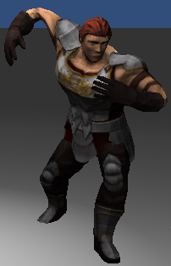
Warrior

Slide 6
Sorceress
Play Style: Elemental DPS
Basic Attack: Ice Spike or Fireball
Depends on current active spell type
Fireball does damage over time
Ice Spike slows enemy for a period of time
Special Attack: Change between Ice and Fire attacks
Class Ability: Blizzard (Ice) or Meteor (Fire)
Blizzard raises a cone of ice spikes in front of Sorceress that freezes enemies
Meteor creates an AoE that deals splash damage to enemies in the contact radius
Resource: Mana
Regenerates over time
Consumed by using special attack
Stats:
Health: C
Speed: B
Attack: A

Slide 7
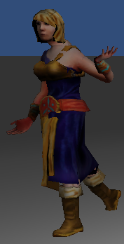
Sorceress

Slide 8
Rogue
Play Style: Melee DPS
Basic Attack: Stab
Executed at every press of the basic attack button (no cooldown)
Increased damage if behind enemy
Special Attack: Dash
Dashes rapidly in direction of movement, if Rogue makes contact with an enemy, he teleports behind them and backstabs them for massive damage
Consumes a lot of energy
Class Ability: Stealth
Rogue does not trigger traps or won’t be attacked by enemies while stealthed
Slowly drains energy over time
Resource: Energy
Regenerates over time and slightly restored by basic attacks and backstabs
Consumed by using special attack and class ability
Stats:
Health: C
Speed: A
Attack: B

Slide 9
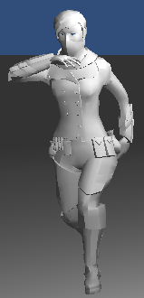
Rogue

Slide 10
Woodsman
Play Style: Range DPS
Basic Attack: Shoot Arrow
Special Attack: Piercing Arrow
Deal more damage and can go through multiple enemies
Woodsman remains stationary while charging shot, can change direction
Class Ability: Mike the Hawk
Hawk flies in the direction the Woodsman is facing, and the hawk will attack nearby enemies and move on to other nearby enemies
Hawk can activate switches and pick up objects it comes into contact with
Slowly drains stamina over time and returns on Class Ability button press or when stamina becomes empty
Resource: Stamina
Regenerates over time
Depletes while hawk is attacking/distracting enemies
Stats:
Health: B
Speed: C
Attack: A

Slide 11
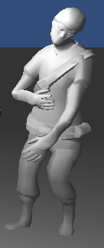
Woodsman

Slide 12
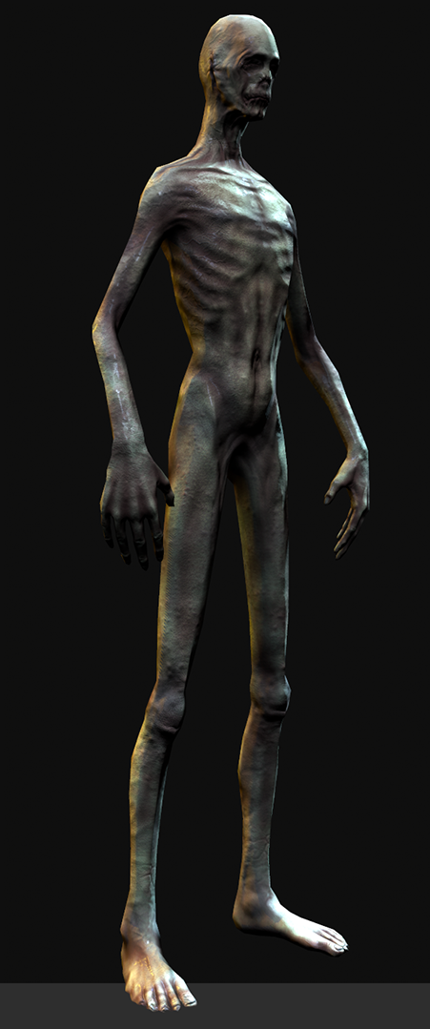
Enemies
The Restless
Once human, the Restless now occupy the underground dungeons in eternal slumber, controlled by the Restless King. With their lack of sight and hearing, they do their best to sense and attack any living being that comes near. Without control of their minds or bodies, they only desire to be put out of their misery to escape their eternal torment.

Slide 13
World
The World is split into dungeons
Dungeons contain 6 to 10 rooms
The group must complete each room to progress through the dungeon
Rooms can contain objects such as traps, interactable items, switches, enemies, etc.
The last room will be a special event or a boss room.

Slide 14
Rooms
Horde Room
The group kills large waves of enemies until none remain, then can progress
Reaction Room
The group rushes to progress through the room while being pushed by a lethal force
Puzzle Room
The group must combine their unique abilities to complete puzzles to progress
Boss Room
The group must defeat a powerful and difficult enemy using skill and cunning

Slide 15
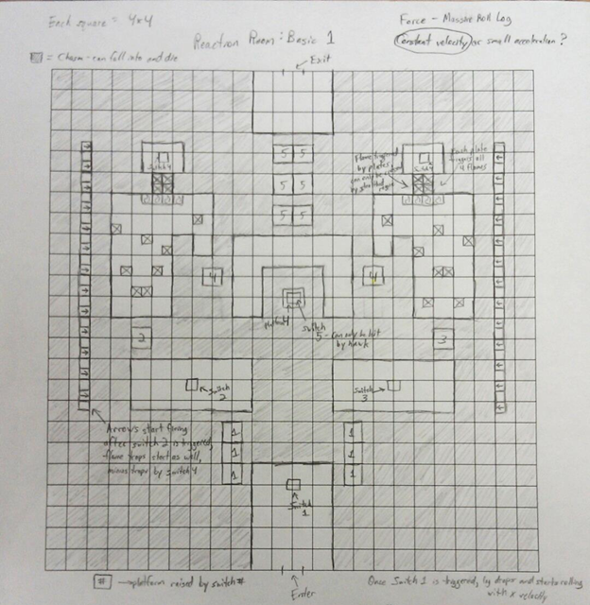
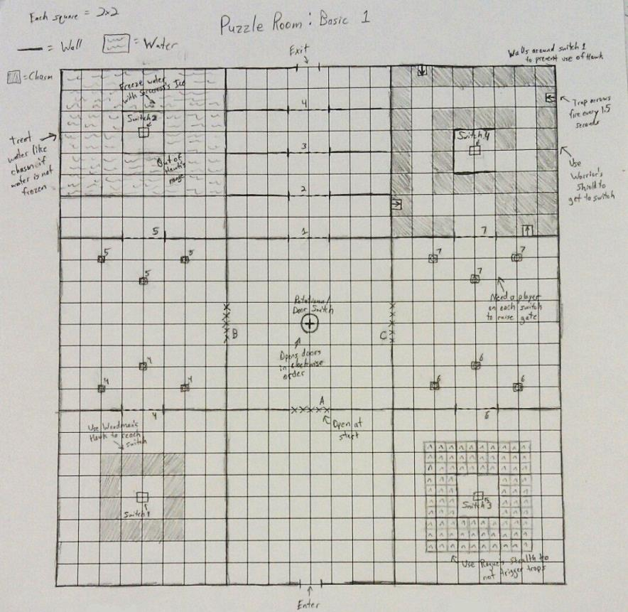
Room Designs

Slide 16
Project Members
Programmers:
Jason Ashworth
Jared Bishop
Corey Cooper
Cody Greenoe
Geoffrey Hall
James Jackson
Jordan Johnson
Nick Linton
Cameron Schuette
Clinton Sexton
Mark Strickland
Vinny Vencill
John Wilson
Artists:
Farrah Allen
Alexander Ashie
Levonne Bolton
Christopher McAlpine
Paige Nissel
Jason Pustulka
Drew Robbins
Dan Slutz
Frank Sanders

